Slide 1
CHARACTERIZATION AND EXPLOITATION OF NESTED PARALLELISM AND CONCURRENT KERNEL EXECUTION TO ACCELERATE HIGH PERFORMANCE APPLICATIONS
Fanny Nina Paravecino
Committee Members:
Prof. David Kaeli (Advisor)
Prof. Ningfang Mi (ECE)
Prof. Qianqian Fang (BioEng)
Dr. Norm Rubin (NVIDIA)

Slide 2
OUTLINE
Motivation
Background
Related Work
Characterization of Advanced Parallel Features
Exploitation of Advanced Parallel Features
Real-World Applications
Conclusions and Future Work

Slide 3
MOTIVATION
Accelerators have evolved rapidly in the last few years
The immediate translation to improved application performance remains challenging
Common applications include a range of programming semantics, including: recursion, graph traversal, and evolutionary algorithms
These algorithms tend to be data-dependent execution
Data-dependent applications exhibit irregular execution and become burdensome for parallel computing
Irregularity in applications generates warp divergence
Notes:
Warp divergence is an inhibitor to parallel computing performance on a GPU

Slide 4
MOTIVATION
Warp Divergence. Warp threads will stall if they are:
Control flow dependent
Data Dependent
Dynamic control-flow dependent loop
0
1
2
3
4
5
6
26
27
28
29
30
31
STALL
IF
IF
IF
IF
IF
IF
STALL
STALL
STALL
STALL
STALL
STALL
ELSE
STALL
STALL
STALL
STALL
STALL
STALL
ELSE
ELSE
ELSE
ELSE
ELSE
ELSE
…

Slide 5
MOTIVATION
How best to leverage nested parallelism in irregular kernels?
Control flow analysis
On-the-fly analysis allows us to quantify the impact of thread divergence
Child kernel launch and synchronization
There are presently no tools to measure the impact of child kernel launch and device synchronization
There is a need to provide guidance to the programmer to effectively implement parallel kernels using nested parallelism
How best to leverage nested parallelism in recursive kernels?
Thread-Level Parallelism
Thread-Level parallelism for each recursive call has to be optimized to exploit GPU resources
Work Efficiency
Ratio of parallel work towards parallel solution of the problem
Overhead of kernel launches

Slide 6
MOTIVATION
Many applications involve the execution of multiple kernels
It is common that kernels over-utilize one resource on the GPU
Notes:
There are resources that are wasted
There is the opportunity to reclaim performance lost
Past GPU parallel computing
Sequential kernel calls
Modern GPU capabilities
Concurrent Kernel Execution:
The ability to call multiple kernels simultaneously

Slide 7
OUTLINE
Motivation
Background
Related Work
Characterization of Advanced Parallel Features
Exploitation of Advanced Parallel Features
Real-World Applications
Conclusions and Future Work
Notes:
Don’t go into single slide deeply, focus on each slide

Slide 8
PARALLEL COMPUTING
Modern GPUs support both advanced parallel features
Nested parallel – NVIDIA (dynamic parallelism), AMD (nested parallelism)
Concurrent kernel execution – NVIDIA (HyperQ), AMD (concurrent kernel execution)
In this work we focus on a CUDA framework and NVIDIA GPUs, though our contributions can be applied to other GPU computing environments

Slide 9
BACKGROUND
/*Parallel code*/
__global__ void kernel()
{
//…
}
/*End Parallel code*/
CUDA
GRID
Thread-Block
Thread-Block
x
y
z
Thread-Block
Thread-Block
Notes:
We exploit parallelism using SIMT, we further exploit the benefits of the framework scheme using kernel, blocks, and threads.

Slide 10
DYNAMIC PARALLELISM
Ability to spawn a child kernel from a parent kernel
Device kernel call
Manage inter-kernel dependencies
Finer thread granularity
Notes:
Better management of conditional-loop execution throughput

Slide 11
DYNAMIC PARALLELISM
Parent Threads
__global__ kernel()
{
//…
if (condition)
childKernel<<<>>
//...
}
…
Child Threads
Parent Threads
With previous GPU generations:
Parent threads would be executed sequentially on the CPU
Or child threads would be executed sequentially for every thread as part of the parent kernel
Or parent kernel and child kernel would be launched by the host, and there would be the overhead of communication between the host and the device

Slide 12
DYNAMIC PARALLELISM
Grid Management Unit allows:
Nested kernel launch
Stream Queues - Ordered queues of grids
. . .
GRID MANAGEMENT UNITS
Pending & suspended grids
Device Kernel Launch
Pausing Grids
Dispatch Grid
Work Distributor
32 Active Grids
SMX
SMX
. . .
SMX

Slide 13
HYPER-Q
Multiple kernels running simultaneously
Multiple streams running
The dispatch of kernels on stream i will not depend on the execution of the kernel on stream j
If there are enough resources to execute both kernels:
Execution of kernels will overlap
Execution
Kernel 0
Kernel 1
…
Kernel 31
Stream 0
Stream 1
Stream 31

Slide 14
OUTLINE
Motivation
Background
Related Work
Characterization of Advanced Parallel Features
Exploitation of Advanced Parallel Features
Real-World Applications
Conclusions and Future Work

Slide 15
RELATED WORK
Nested Parallelism
Di Marco et al. [SPIE 2013]: Performance impact of dynamic parallelism on different clustering algorithms
Wang et al. [IISWC 2014]: Characterization and analysis of dynamic parallelism in unstructured GPU applications
Wang et al. [ISCA 2015]: Dynamic thread block launch: a lightweight execution mechanism to support irregular applications on GPUs
Yang et al. [JCST 2015]: CUDA-NP: Realizing nested thread-level parallelism in GPGPU applications
Zhang et al. [IA3 2015]: Dynamic parallelism for simple and efficient GPU graph algorithms
Li et al. [ICCP 2015]: Nested parallelism on GPU: Exploring parallelization templates for irregular loops and recursive computations
Wang et al. [GTC 2016]: Exploring dynamic parallelism for irregular applications on GPUs

Slide 16
RELATED WORK
Concurrent Kernel Execution
Wang et. al. [HPCS 2011]: Exploiting concurrent kernel execution on graphic processing units
Wende et al. [SAAHPC 2012]: On improving the performance of multi-threaded CUDA applications with concurrent kernel execution by kernel reordering
Gregg et al. [HotPar 2012]: Fine-grained resource sharing for concurrent GPGPU kernels
Jog et al. [GPGPU 2014]: Application-aware memory system for fair and efficient execution of concurrent GPGPU applications
Luley et al. [IPDPSW 2016]: Effective utilization of CUDA Hyper-Q for improved power and performance efficiency
Notes:
Gregg presented a KernelMerge a kernel scheduler

Slide 17
OUTLINE
Motivation
Background
Related Work
Characterization of Advanced Parallel Features
Exploitation of Advanced Parallel Features
Real-World Applications
Conclusions and Future Work

Slide 18
CHARACTERIZATION OF NESTED PARALLELISM
Control flow instructions
Special emphasis in: control flow dependent-loops
On-the-fly characterization:
instExec: Instructions Executed [nvprof]
warpDivEff: Warp Divergence Efficiency [nvprof]
cfDependentNestedLoop: Control Flow Dependent Nested Loop [SASSI]

Slide 19
CHARACTERIZATION OF NESTED PARALLELISM
We define and evaluate the following metrics:
loopInstExec = cfDependentNestedLoop/instExec
warpDivIdle = 1 − (warpDivEff/100)
loopWarpThreadsIdle = warpDivIdle ∗ loopInstrExec
loopWarpEff = (1 − loopWarpThreadsIdle) ∗ 100
Notes:
Fanny – provide a subbullet for each metric to describe it in plain words

Slide 20
CHARACTERIZATION OF NESTED PARALLELISM
Dynamic parallelism allows explicit synchronization using API CudaDeviceSynchronization
We characterize its overhead by using clocks
SMUsage is another metric to control the point when the number of available SMs is exhausted:
SMUsage = (NumberThreadsPerBlock ∗ NumberBlocks)/ MaxThreadsPerSM

Slide 21
CHARACTERIZATION OF NESTED PARALLELISM
Micro-benchmark
__global__ void singleKernel(int* A, int *B, int *C, int rows, int cols)
{
int idx = blockIdx.x *blockDim.x + threadIdx.x;
if(A[idx*cols] == 1)
{
for(int i=0; i < cols; i++)
C[idx*cols + i] = A[idx*cols + i] + B[idx*cols + i];
}
}

Slide 22
CHARACTERIZATION OF NESTED PARALLELISM
Impact of the rate of divergence on GTX Titan
Notes:
Lower is better

Slide 23
CHARACTERIZATION OF NESTED PARALLELISM
Micro-benchmark with 75% divergent code, run across different GPUs
Notes:
Lower is better

Slide 24
CHARACTERIZATION OF NESTED PARALLELISM
Parallel recursion
For instance: Breadth-First Search (BFS)
1
0
4
Level 0
0
2
3
5
1
0
4
1 | 3
Result of BFS
Level 1
0
1
2
3
4
5
Vertex
2
3
5
0 | 1 | 2 | 1 | 2 | 2
Level Array
1
0
4
Level 2
2
4 | 5
2
3
5

Slide 25
CHARACTERIZATION OF NESTED PARALLELISM
Parallel recursion
For instance: Breadth-First Search
1
0
4
0
# Kernel Calls: 1, initial source in node 0
Level 0
2
3
5
Total threads spawned: 2
1
0
4
Level 1
1 | 3
# Nested Kernel Call: 2
2
3
5
Total threads spawned: 3
1
0
4
Level 2
2
4 | 5
Arrive at base case
2
3
5
No more nodes to visit

Slide 26
CHARACTERIZATION OF NESTED PARALLELISM
Parallel recursion
Degree of thread-level parallelism
Based on the the # of outgoing edges per node - yields poor thread-level parallelism
Degree of thread-level parallelism - dominates the effectiveness using a GPU
Guideline: Increase thread-level parallelism
Number of kernel launches
Based on # of visited node launches – lead to an excessive number of nested kernel, increasing the queue of pending grid to execute at the GMU
Guideline: Reduce the number of kernel launches
Work Efficiency
Multiple threads can arrive at the same node and visit it multiple times
Doubling work on the same node is wasted work
Guideline: Increase work efficiency by avoiding multiple visits to same node

Slide 27
CHARACTERIZATION OF CONCURRENT KERNEL EXECUTION
To fully understand resource contention, we need to characterize resource usage
Persistent Threads allow us to use dedicated threads, resident as the hardware threads, but they require modification of the kernel implementation
Resource utilization varies dramatically across different GPU architectures

Slide 28
CHARACTERIZATION OF CONCURRENT KERNEL EXECUTION
Resource contention
Non-Persistent Thread versus Persistent Threads
__global__ void persistentKernel(int *A, int *B, int *C, int workload, int rows, int cols)
{
int idx = blockIdx.x * blockDim.x + threadIdx.x;
idx = idx * workload;
int workloadProcessed = 0;
while(workloadProcessed < workload){
if(A[(idx+workloadProcessed)*cols] == 1)
{
for(int i=0; i < cols; i++){
C[(idx+workloadProcessed)*cols+i] = A[(idx+workloadProcessed)*cols+i]+B[(idx+workloadProcessed)*cols+i];
}
}
workloadProcessed++;
}
}

Slide 29
CHARACTERIZATION OF CONCURRENT KERNEL EXECUTION
Sequential / HyperQ / Non Persistent Threads / Persistent Threads

Slide 30
CHARACTERIZATION OF CONCURRENT KERNEL EXECUTION
Resource contention analysis - Non Persistent Threads

Slide 31
CHARACTERIZATION OF CONCURRENT KERNEL EXECUTION
Resource contention analysis – Persistent Threads

Slide 32
OUTLINE
Motivation
Background
Related Work
Characterization of Advanced Parallel Features
Exploitation of Advanced Parallel Features
Real-World Applications
Conclusions and Future Work

Slide 33
EXPLOITATION OF ADVANCED PARALLEL FEATURES
Selective Matrix Add
__global__ void singleKernel(int* A, int *B, int *C, int rows, int cols)
{
int idx = blockIdx.x *blockDim.x + threadIdx.x;
if(A[idx*cols] == 1)
{
for(int i=0; i < cols; i++)
C[idx*cols + i] = A[idx*cols + i] + B[idx*cols + i];
}
}
Using our framework
Input Size (MB) | loopWarpEff Non-Nested Parallelism | loopWarpEff Nested Parallelism
4 | 53% | 100%
16 | 53% | 100%
64 | 53% | 100%
196 | 53% | 100%

Slide 34
EXPLOITATION OF ADVANCED PARALLEL FEATURES
Selective Matrix Addition

Slide 35
EXPLOITATION OF ADVANCED PARALLEL FEATURES
Breadth-First Search - Naïve Nested Parallelism
Running on GTX Titan
Input Graph | Vertices x Edges | Naive Nested Parallelism Time (ms) | Recursive Kernel Calls | Work Eff.
Delaunay Triang10 | 1024 x 6112 | 362.34 | 14274 | 82.18%
Delaunay Triang11 | 2048 x 12254 | 608.24 | 24458 | 82.01%
Delaunay Triang12 | 4096 x 24528 | 953.56 | 37701 | 81.69%
Rome routes network | 3353 x 8870 | 121.07 | 3870 | 56.09%
Breadth-First Search – Optimized Nested Parallelism
Running on GTX Titan
Input Graph | Vertices x Edges | Optimized NP Time (ms) | Recursive Kernel Calls | Work Eff.
Delaunay Triang10 | 1024 x 6112 | 3.64 | 750 | 99.83%
Delaunay Triang11 | 2048 x 12254 | 3.89 | 1729 | 99.92%
Delaunay Triang12 | 4096 x 24528 | 65.27 | 2746 | 99.96%
Rome routes network | 3353 x 8870 | 3.29 | 828 | 99.95%

Slide 36
EXPLOITATION OF ADVANCED PARALLEL FEATURES
Breadth-First Search Speedup compare to non-nested parallelism
Nodes
Edges

Slide 37
EXPLOITATION OF ADVANCED PARALLEL FEATURES
Prim’s algorithm - Naïve Nested Parallelism
Running on GTX Titan
Input Graph | Vertices x Edges | Naïve Nested Parallelism Time (ms) | Nested Kernel Calls
Delaunay Triang11 | 2048 x 12254 | 122.64 | 2048
Rome routes network | 3353 x 8870 | 180.73 | 3353
Prim’s algorithm – Optimized Nested Parallelism
Running on GTX Titan
Input Graph | Vertices x Edges | Optimized Nested Parallelism Time (ms) | Nested Kernel Calls
Delaunay Triang11 | 2048 x 12254 | 4.86 | 25
Rome routes network | 3353 x 8870 | 21.95 | 64

Slide 38
OUTLINE
Motivation
Background
Related Work
Characterization of Advanced Parallel Features
Exploitation of Advanced Parallel Features
Real-World Applications
Conclusions and Future Work

Slide 39
REAL-WORLD APPLICATIONS
Connected Component Labeling
Running on GTX Titan
Input Pixels (KPixels) | Non Nested Parallelism (s) | Nested Parallelism (s) | Speedup | loopWarpEff Non Nested Parallelism | loopWarpEff Nested Parallelism
512 | 0.98 | 0.20 | 4.92 | 24% | 99%
1024 | 1.96 | 0.32 | 6.16 | 56% | 59%
1536 | 2933.32 | 638.02 | 4.60 | 77% | 100%

Slide 40
EXPLOITATION OF ADVANCED PARALLEL FEATURES
Level-Set Segmentation
Running on GTX Titan

Slide 41
OUTLINE
Motivation
Background
Related Work
Characterization of Advanced Parallel Features
Exploitation of Advanced Parallel Features
Real-World Applications
Publications
Conclusions and Future Work

Slide 42
PUBLICATIONS TO DATE
Fanny Nina-Paravecino, Leiming Yu, Qianqian Fang, David Kaeli, “High-performance Monte Carlo Simulations for Photon Migration and Applications in Optical Brain Functional Imaging”, Handbook of Large-Scale Distributed Computing in Smart Healthcare, 2016
Julian Gutierrez, Fanny Nina-Paravecino, and David Kaeli. "A fast level-set segmentation algorithm for image processing designed for parallel architectures." Proceedings of the Sixth Workshop on Irregular Applications: Architectures and Algorithms(IA^3). IEEE Press, 2016.
Fanny Nina-Paravecino, Leiming Yu, Qianqian Fang, and David Kaeli. “MCX: Accelerated Monte Carlo Simulation of Photon Migration in 3D Turbid Media.” High Performance Computing Day. HPC Day May 2016.
Fanny Nina-Paravecino, Leiming Yu, Qianqian Fang, and David Kaeli. "Portable Performance for Monte Carlo Simulations of Photon Migration in 3D Turbid Media for Single and Multiple GPUs." GPU Technology Conference. GTC, April 2016.
Fanny Nina-Paravecino, and David Kaeli. "Real-Time Image Segmentation for Homeland Security Exploiting Hyper-Q Concurrency." GPU Technology Conference. GTC, March 2015.

Slide 43
PUBLICATION TO DATE
Saoni Mukherjee, Xiang Gong, Leiming Yu, Carter McCardwell, Yash Ukidave, Tuan Dao, Fanny Nina-Paravecino, and David Kaeli. “Exploring the Features of OpenCL 2.0”. International Workshop on OpenCL. IWOCL, 2015.
Yash Ukidave, Fanny Nina-Paravecino, Leiming Yu, Charu Kalra, Amir Momeni, Zhongliang, Chen, Nick Materise, Brett Daley, Perhaad Mistry and David Kaeli. "NUPAR: A Benchmark Suite for Modern GPU Architectures." International Conference on Performance Engineering. ICPE, 2015.
Fanny Nina-Paravecino, Evan Hovaniak, and David Kaeli. “Image Segmentation using Graph Analysis on GPUs”, Boston Area Architecture Workshop. BARC 2015.
Fanny Nina-Paravecino, and David Kaeli. "Accelerated Connected Component Labeling Using CUDA Framework." Computer Vision and Graphics. Springer International Publishing. ICCVG 2014. 502-509.

Slide 44
OUTLINE
Motivation
Background
Related Work
Characterization of Advanced Parallel Features
Exploitation of Advanced Parallel Features
Real-World Applications
Publications
Conclusions and Future Work

Slide 45
CONCLUSIONS
Contributions:
We characterized irregular applications on GPUs, identifying when we can leverage nested parallelism. We evaluated three workload components:
control flow workload analysis
child kernel launching
child kernel synchronization
We utilized SASSI (SASS instrumentation tool) and developed binary-injection handlers to collect and measure the control dependent loop efficiency

Slide 46
CONCLUSIONS
Contributions:
We characterized recursive parallel workloads, and evaluated three components:
Degree of thread-level parallelism
Work efficiency
Overhead of kernel launches
We characterized the execution of concurrent kernels. Our characterization captures:
Kernel launch configuration
Resource consumption

Slide 47
CONCLUSIONS
Contributions
We proposed and evaluated kernels with persistent threads as a mechanism to control resource contention for concurrent kernel execution on GPUs
Our proposed set of metrics have been applied to a number of CUDA kernels taken from the problem domains of image processing, linear algebra, and graph theory problems.
We achieved speedups of 5x-29x speedup, as compared to non-optimized kernels that used NVIDIA’s advanced parallelization features

Slide 48
FUTURE WORK
New avenues of research:
Our proposed characterization and exploitation can be extended to support multi-GPU systems with different resources capabilities
It also can be extended to support multiple applications execution on GPUs

Slide 49
ACKNOWLEDGEMENT
Advisor
Prof. David Kaeli
Committee Members
Prof. Qianqian Fang
Prof. Ningfang Mi
Dr. Norm Rubin
All NUCAR members
Special thanks to Leiming, Julian, Fritz, Xiangyu, Zhongliang and Saoni for all the support, collaboration and encouragement in this doctoral journey
Family and Friends
Mom and Dad, Fani and Dante
Siblings, Reykjavil and Lisbeth
Boyfriend, Jose
Oscar, Ruth, Ben, Ernesto, and everyone that helped and supported the long path of my doctoral journey

Slide 50
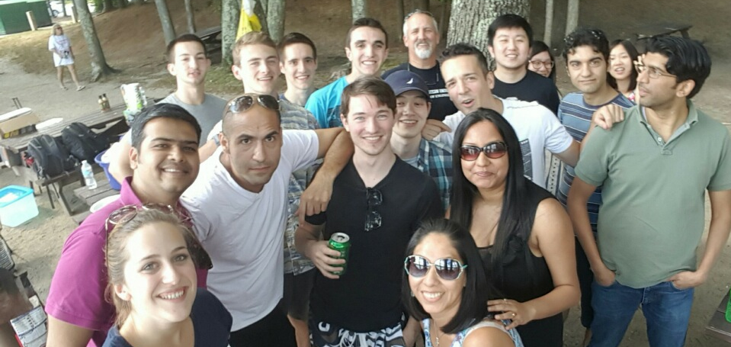
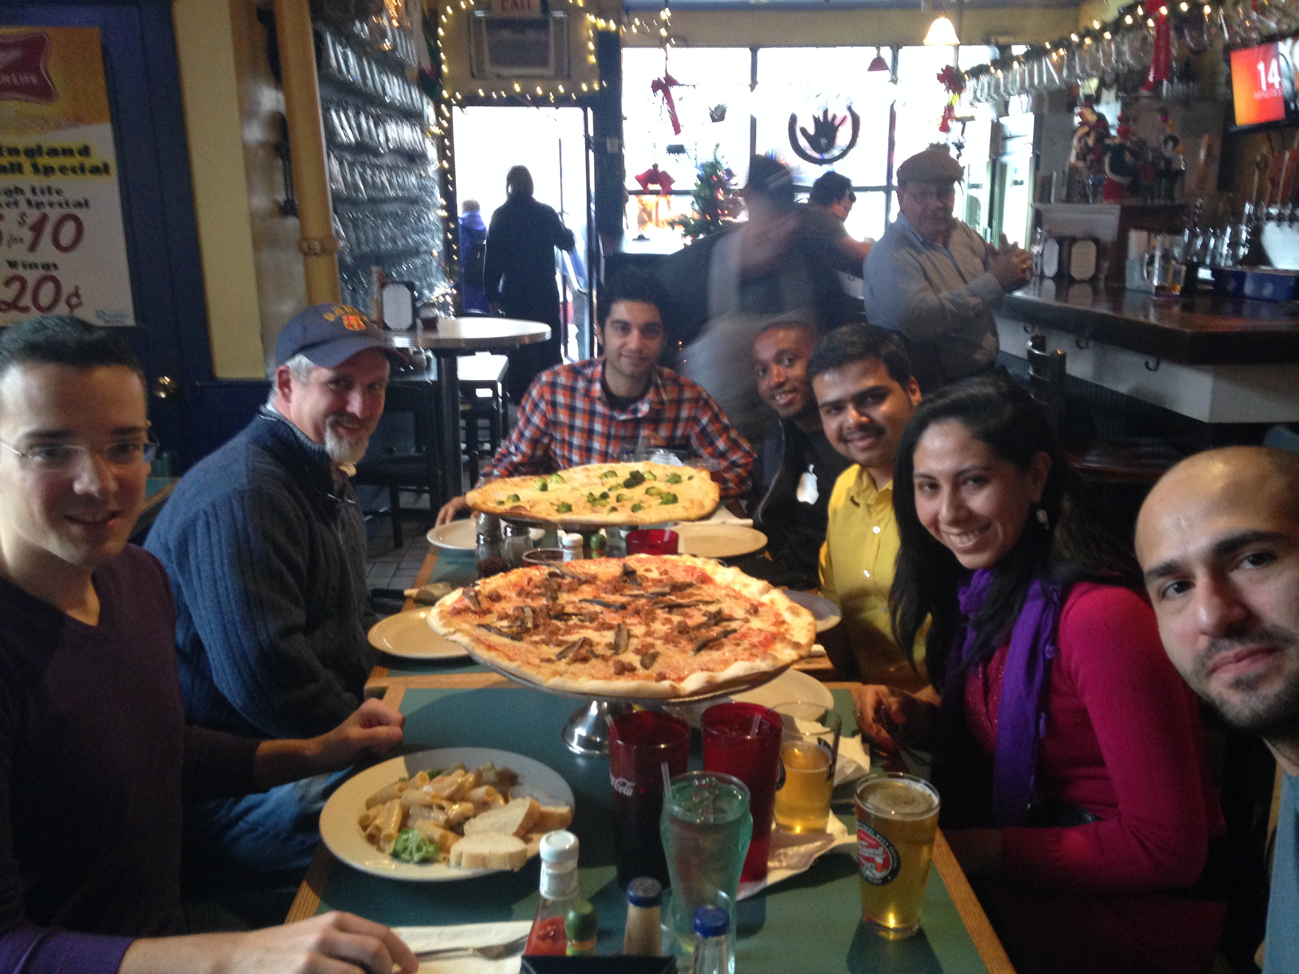
THANK YOU!
QUESTIONS?
fninaparavecino@ece.neu.edu

Slide 51
Concurrent Kernel Execution - MCX

